Slide 1
Containers and Orchestrators
Notes:
Introduction to the Cloud

Slide 2
Overview
Container Images
The Container Lifecycle
Orchestration (Swarm, Kubernetes, etc)
Container Networking
Kubernetes

Slide 3
System calls
System Call
Application
Kernel
Disk
open(" /test.txt", "r")
| Source: Wikipedia/Pdesousa359 under CC BY 3.0
Notes:
In the second lecture we have talked about how applications interact with the kernel and the hardware. By now you know that applications running in ring 3 do not have direct access to things like the disk. To access those details they need to execute a system call to the kernel. The kernel will then give the application the details required, for example a file from the disk.

Slide 4
System calls
Application
Disk
open(" /test.txt", "r")
Kernel
open(" /test.txt", "r")
Application
Disk
| Source: Wikipedia/Pdesousa359 under CC BY 3.0
Notes:
Let's play a hypothetical game: process A wants to access a file called test.txt. It calls the kernel, the file is opened, and process A is now free to read the contents. When process B comes along and does the same, it will receive the same file.
Or does it? In the Linux kernel the filesystem root directory (starting with /) is a virtual construct that can be changed on a per-process basis. It is possible to make process A see a completely different folder structure then process B. This mechanism is called chroot. It is, in fact, so old that it predates Linux by more than a decade and was first present in Version 7 Unix in 1979.

Slide 5
Process Collaboration
Network
Interprocess Communication (IPC)
Signals
etc
| Source: Wikipedia/Pdesousa359 under CC BY 3.0
Notes:
This alone only isolates the two processes on a filesystem level, there are still plenty of opportunities for two processes to interact, for example:
On the network
Interprocess Communication (IPC)
Sending signals to each other by process ID
etc.

Slide 6
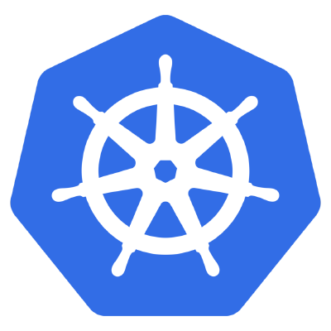

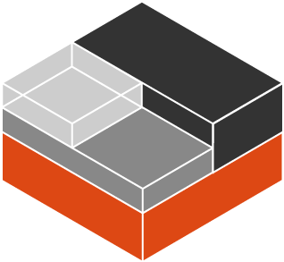
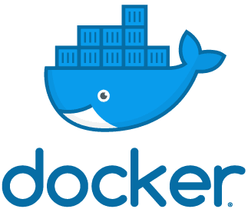
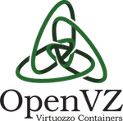
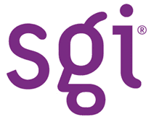

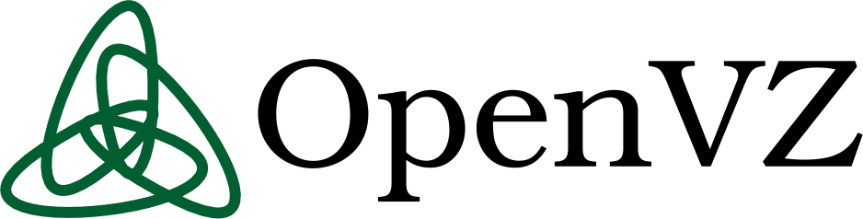
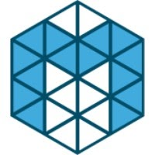

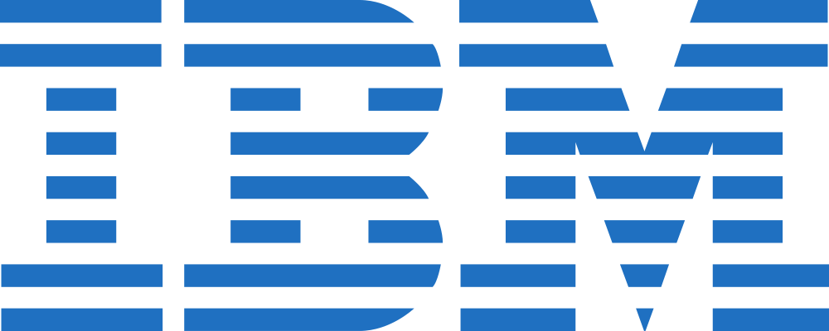
Containers
Notes:
In the early 2000's there were two projects that attempted to implement process isolation in the Linux kernel: OpenVZ and Linux-VServer. Running these projects required patching and recompiling the Linux kernel from source.
Starting around 2006 several companies, including Google, IBM, SGI, Bull, and the OpenVZ project itself has put significant effort into taking OpenVZ apart and piece by piece and submitting it to the Linux kernel. The User Beancounters from OpenVZ, for example, became cgroups and allow resource allocation to a group of processes.
Do you want to know more about history?
The history of containerization is surprisingly hard to piece together despite the relative young age of the technology. If you want a bit of a deeper dive take a look at “A Brief History of Containers (by Jeff Victor & Kir Kolyshkin)”.

Slide 7
Containers
Virtual Network Card
Process Separation
Separate Filesystem
Restricted IPC
User separation
| Source: Wikipedia/Pdesousa359 under CC BY 3.0
Notes:
All these isolation technologies, together, form what's today known as Linux containers. Windows has undergone a similar development in recent years, and has virtualized the typical Windows interaction points between processes: job objects, process table, registry, filesystem, etc.
In essence, containers don't exist. They are a collection of technologies that provide process-level isolation for an application. These isolation techniques can, among others, include:
A separate, virtual network card
Process separation (no ability to send signals to other containers)
A separate view of the filesystem
Restricted IPC between containers
User separation / user ID mapping
Do you want to build your own container engine?
You can! Take a look at Liz Rice's Containers From Scratch talk!

Slide 8

Container Images
Source: Unsplash/Julius Drost under Unsplash License

Slide 9
Dockerfile
FROM ubuntu:20.04
RUN apt update &&
apt install –y nginx &&
rm /var/lib/apt/lists/*
CMD ["/usr/sbin/nginx","-g","daemon off;"]
| Source: Wikipedia/Pdesousa359 under CC BY 3.0
Notes:
Docker was not the first technology to create containers using the modern Linux API's, but it was the one that made containers popular. The edge Docker had over its competitors was the way it dealt with images. Other container solutions at the time, like LXC, tried to emulate virtual machines where a full operating system would be installed, and then updated. Docker chose a different route. A Dockerfile would contain the instructions needed to build a container image containing the application that should be containerized. These instructions would be executed and resulted in a container image. This container image could then be used to launch one or more copies of it.
Since the container image contains everything the application needs to run these images are ideal operating system independent packages. This solves the age-old problem of having to install the correct version of the runtime environment (PHP, Python, Java, etc) as it is contained within the container image.

Slide 10
Dockerfile
FROM ubuntu:20.04
RUN apt update &&
apt install –y nginx &&
rm /var/lib/apt/lists/*
CMD ["/usr/sbin/nginx","-g","daemon off;"]
Difference
Difference
Difference
| Source: Wikipedia/Pdesousa359 under CC BY 3.0
Notes:
When a container is run this container image is the basis for all the data that is contained within. The data is, however, not copied. If the application modifies or creates files only the difference is stored. This makes containers very lightweight on the storage front as well.

Slide 11

Registry
Version Control System
CI/CD
Container Orchestrator
Application
Runtime
Registry
Worker Node
Container
Notes:
Docker went one step further, they introduced a way to share images between machines using a registry, a server that stores container images. The public Docker hub contains a vast array of images built by the community. These technologies were later all standardized under the Open Container Initiative, creating a company-independent format for containers and technologies around them.
Warning
Third party container images should be treated with the same due diligence like installing third party software on your computer! They can contain malicious code and can cause harm despite the containerization.

Slide 12

Container Lifecycle
Source: Unsplash/Matheo JBT under Unsplash License

Slide 13
Immutable Infrastructure
Containers are not updated
They are replaced
Data is persisted with volumes
Notes:
You can, of course, update a running container just as you would a traditional virtual machine. However, that is not the intended, or indeed, optimal way to use them. The intention of containers is immutable infrastructure. Immutable infrastructure means that containers are never updated. Instead, they are replaced. When a new version of a software needs to be installed the old container is shut down and a new one is launched from a new image.
Immutable infrastructure presents a massive benefit: instead of having to deal with a downtime when the upgrade is ran, the updated version can be tested before it is launched.
However, this concept reaches its limits when it comes to running software that needs to store data in a persistent fashion, for example, databases. For this purpose containers can designate special folders to be mounted as volumes. Volumes can be persisted by either mounting them as a folder from the host machine, or by mounting a network-based storage system.

Slide 14
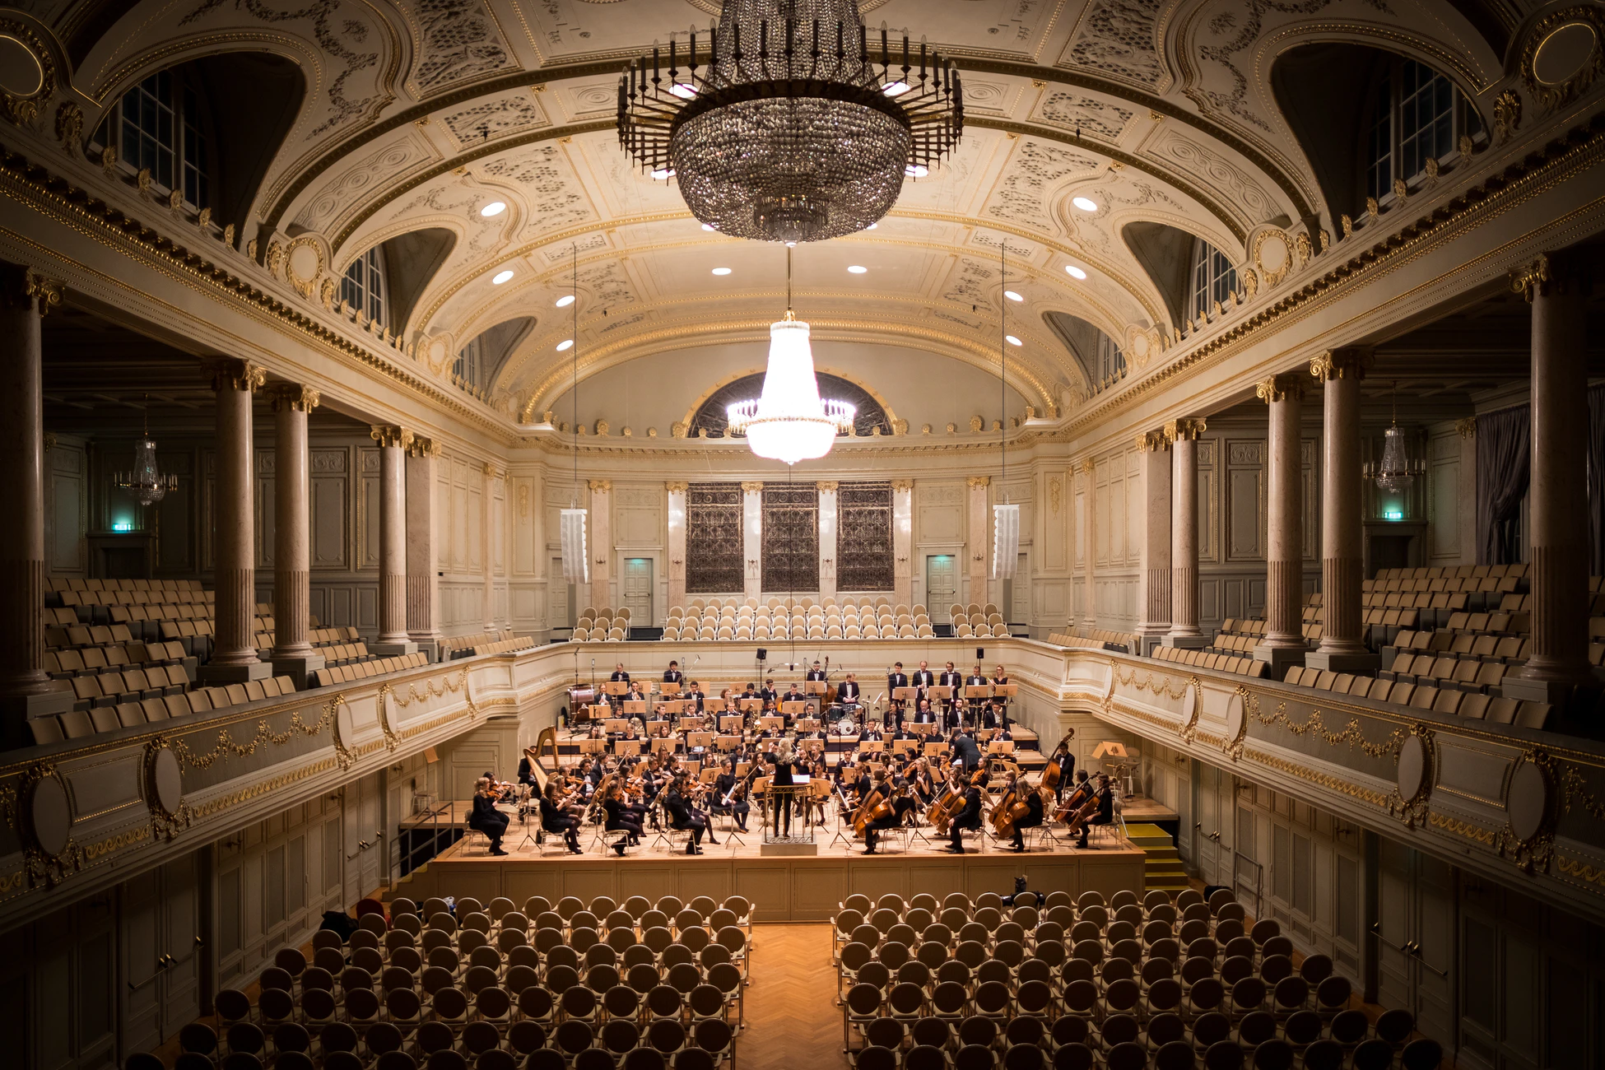
Container Orchestration
Source: Unsplash/Manuel Nägeli under Unsplash License

Slide 15
Orchestration
Container Orchestrator
Worker Node
Worker Node
Worker Node
Notes:
Docker and other container runtimes do not manage containers across multiple servers by themselves. Docker has received an addon called Docker Swarm, but nowadays the clear winner of the “Container Wars” is Kubernetes.
Container orchestrators are responsible for determining which server has free capacity and schedule containers to run on them. When a server fails these orchestrators are responsible for discovering it and re-launching them on a different server.
Furthermore, container orchestrators contain a certain amount of integration with the cloud providers. Docker Swarm has very basic integrations, but Kubernetes on the other hand, has integrations with just about anything.
Depending on the cloud provider Kubernetes can automatically move block storage mounts to a different server when a container is moved, configure cloud load balancers and much more.
This flexibility comes at a cost: Kubernetes is very complex. A detailed explanation on how to deploy an application on Kubernetes would vastly exceed the bounds of this course. If you are interested in this topic we recommend taking a look at one of the many Certified Kubernetes Application Developer courses on the Internet.

Slide 16
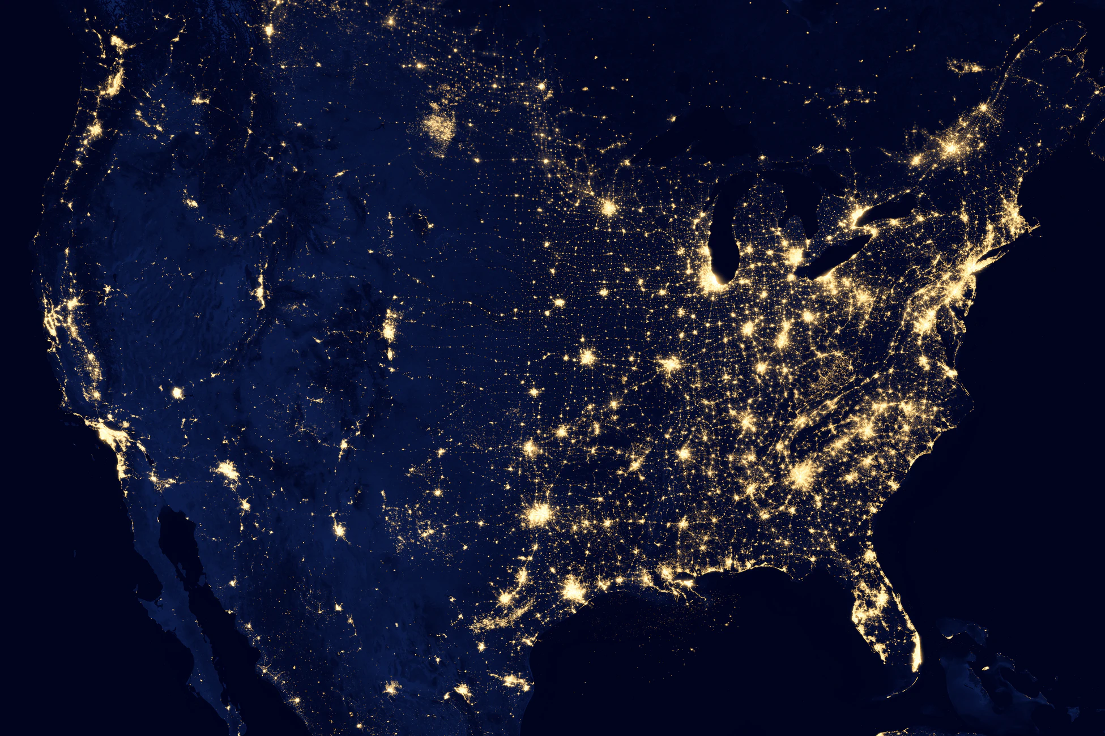
Container Networking
Source: Unsplash/NASA under Unsplash License

Slide 17
Docker Networking
Worker Node
eth0
NAT
docker0 (bridge)
veth0
veth1
veth2
Container
Container
eth0
eth0
eth0
Container
Notes:
As mentioned previously, containers regularly have their own, virtual network interfaces. This virtual network interface can be connected in a number of ways.
If we take a look at Docker's default networking model the virtual network interface is connected to an internal network bridge. This enables containers to connect to each other. For connections to the Internet a NAT is performed.

Slide 18
Overlay Networking
Worker Node
Worker Node
Container
Container
Container
Container
Container
Container
Notes:
More advanced options for container networking create a single virtual network across several hosts and connect the containers to this virtual network. This is an option with Docker Swarm and is always the case with Kubernetes.
When you look at these graphics, one question may come to mind: the cloud is quite dynamic in its nature, so how does a Kubernetes cluster receive incoming connections? After all, each of the nodes may be replaced with a new one, with a new IP address at any time? This is where the immense feature set of Kubernetes begins to show itself. Kubernetes includes several controllers that can interact with cloud providers in a variety of ways. One of these integrations can be, for example, the load balancer integrations. The Kubernetes network can be extended to a load balancer and that load balancer can send traffic directly over the virtual network used by the containers.

Slide 19
Firewalls
Worker Node
Worker Node
Container
Container
Container
Container
Container
Container
Notes:
Further helping the dynamic nature of the cloud are features like the ability to create internal firewalls. These firewalls can help mitigate possible security vulnerabilities like SSRF. Since these firewalls can be created using the same API as the software deployment, the firewall rules for an application can be versioned in Git, for example.
Since everything required to run an application can be stored in a Dockerfile and a Kubernetes manifest the application source code can be self-contained. This is, of course, only true if the application is written in such a way that workes well with the cloud. This is described in the next lecture.

Slide 20

Kubernetes
Source: Unsplash/Zoltan Tasi under Unsplash License
Notes:
We have talked about Kubernetes before, but we are dedicating this section to more detail as it has become quite apparent that Kubernetes is going to be the de-facto standard for container orchestration in the future.
The history of Kubernetes lies in the Borg orchestrator from Google. The intention is to be able to orchestrate workloads across thousands of machines. Since Kubernetes is highly scalable its design is difficult to use at small scale.

Slide 21
Basic Structure
Deployment
ReplicaSet
Pod
Container
Container
Notes:
Developers using Kubernetes are only confronted with a subset of Kubernetes' complexity. A developer can create a Kubernetes manifest file (in YAML format) that instructs Kubernetes to run a certain set of containers, network them together, provide load balancers, etc.
The basic unit of scheduling is a Pod. A pod is a unit consisting of one or more containers that share a network namespace and can potentially also share other resources. Pods can either run continuously or can be scheduled to run to completion for one-off jobs or cronjobs.
However, unlike a simple Docker installation Kubernetes offers a way to manage Pods on a higher level. Deployments offer a way to create a resource to manage downtimeless deployments and roll back to a previous version with a simple rollback command if desired. They do this by using ReplicaSets, an automatic resource creating multiple copies of a Pod.
As you can already see this highlights what we will discuss in the next lecture: a cloud-native application has to be ready to have multiple parallel copies of itself running.

Slide 22
StatefulSet
StatefulSet
Pod id=1
Pod id=2
Pod id=3
Container
Container
Container
Container
Container
Container
Notes:
For more difficult workloads Kubernetes also includes a StatefulSet. StatefulSets give a developer the ability to guarantee a predictable startup sequence of multiple Pods as well as a unique ID for each. This is especially important for replicated databases.

Slide 23
DaemonSet
DaemonSet
Worker Node
Worker Node
Worker Node
Pod
Pod
Pod
Container
Container
Container
Container
Container
Container
Notes:
DaemonSets are, on the other hand, a special workload type more geared towards Kubernetes administrators, offering the ability to run a workload on every node of the cluster. This is often used to run utility Pods such as log collectors, monitoring agents, etc.

Slide 24
Persistent Volumes
Pod
Container
Container
PersistentVolumeClaim
PersistentVolume
Notes:
Since some Pods need to store data Kubernetes offers a flexible way to allocate storage in the cloud with the use of PersistentVolumeClaims (PVC) and PersistentVolumes (PV). A Kubernetes administrator would set up a PV which a developer then uses using a PVC. This decouples the developers and administrators work nicely.
It is worth remembering though that a single PV can only be used by a single PVC. This makes allocation in a larger cluster cumbersome. Naturally, Kubernetes has a solution for this problem called provisioners. These provisioners can dynamically create PVs as needed, usually by creating a network block storage volume in the cloud.
It is also worth noting that, while local storage is supported, it provides no resilience against host machine failure, as we discussed in lecture 2. While Kubernetes will do its best to support local storage and won't reschedule a workload with such an attached storage, it also limits the ability for Kubernetes to react to a node failure and move workloads.

Slide 25
Services
Service app=nginx
Endpoint app=nginx
Endpoint app=nginx
Pod app=nginx
Pod app=nginx
Container
Container
Container
Container
Notes:
In order to facilitate internal and external load balancing Kubernetes introduces the concept of Services to create internal network load balancers for each service. These services use the Pod labels to track which Pods they should send traffic to.

Slide 26
Load Balancers
Load Balancer
Worker Node
Worker Node
Worker Node
Pod
Container
Container
Notes:
A special type of service is the Loadbalancer which, given a cloud integration, dynamically creates an external IP address for a specific service.

Slide 27
Ingress
Load Balancer
Worker Node
Worker Node
Worker Node
Pod
Ingress Controller
Container
Container
Container
Container
Notes:
Alternatively, workloads can also make use of the Ingress resource that dynamically configures the ingress controller to send HTTP workloads to specific pods. The ingress controller acts as an application load balancer for Kubernetes.

Slide 28
Jobs & CronJobs
Job: Runs once, to completion. Can be retried.
CronJob: Launches Jobs periodically
Notes:
To augment these capabilities the Job resource gives developers the ability to use Kubernetes as a queue system and run one-off workloads. To run regular jobs the CronJob resource can be used.

Slide 29
Architecture
Kubectl
CNI
Master
etcd
database
Controller-Manager
API server
Scheduler
Cloud Controller
Worker Node
Kube-proxy
Kubelet
Notes:
The Kubernetes architecture is highly modular and the description given here is fairly generic. Individual Kubernetes distributions may differ greatly in their use of tools.
At the core of Kubernetes is the API server. This central piece is the endpoint for both the clients (for example the Kubernetes CLI called kubectl), other orchestrator components such as the controller-manager, cloud controller, or scheduler, and also the workload coordinator called the `kubelet.
The scheduler is responsible for deciding which container is supposed to run on which worker node. As the name says, it schedules the workload.
The controller-manager is a component composed of many small parts that decides what to run. For example, the ReplicaSet controller is responsible for creating multiple copies of the same pod.
The cloud controller is responsible for the cloud provider integration. This is optional for a static cluster, but required if autoscaling, or a load balancer integration is required.
The kubelet runs on every node and is responsible for talking to the Container Runtime (e.g. containerd) to run the containers the scheduler deems necessary. It is worth mentioning that the Kubelet must be able to reach the API server on a network level, and vice versa. HTTP request flow in both directions in order to make a Kubernetes cluster work.
The kube-proxy service also often runs on each Kubernetes node to provide load balancing, but there are replacements for this component.
The Container Network Interface (CNI) is a network plugin deployed alongside the kubelet and provides the previously-described overlay network. There is a wide range of CNI plugins from bare metal routing to Calico.
As a final piece of the puzzle Container Storage Interfaces (CSI) provide a way to integrate just about any storage provider as a driver for PVs.

Slide 30

Thank you!
Source: Unsplash/Wilhelm Gunkel under Unsplash License

